Slide 1





310243- System Programming & Operating System
Unit No.: 1
Unit Name: Introduction
Unit Outcomes: To analyze basic System Software and its functionality.
DR.D.Y.PATIL INSTITUTE OF TECHNOLOGY

Slide 2

Syllabus
Introduction to Systems Programming
Need of Systems Programming
Software Hierarchy
Types of software: system software and application software
Machine structure
Evolution of components of Systems Programming Text Editors, Assembler, Macros
Compiler, Interpreter, Loader, Linker, Debugger Device Drivers, Operating System
Elements of Assembly Language Programming: Assembly Language statements, Benefits of Assembly Language
A simple Assembly scheme, Pass Structure of Assembler.
Design of two pass Assembler: Processing of declaration statements
Assembler Directives and imperative statements, Advanced Assembler Directives
Intermediate code forms, Pass I and Pass II of two pass Assembler.
DR.D.Y.PATIL INSTITUTE OF TECHNOLOGY
DR.D.Y.PATIL INSTITUTE OF TECHNOLOGY

Slide 3
Introduction to System Programming
What is System?
System is the collection of various components.
Ex:- College is a system
What is Programming?
Art of designing and implementing the programs.
Software is collection of many programs. Two types of software:
1. System software-
These programs assist general use application programs.
Ex:- Operating System , Assembler etc.
2. Application software-
These are the software developed for the specific goal.
System programming involves designing and writing computer programs that allow the computer hardware to interface with the programmer and the user, leading to the effective execution of application software on the computer system. Typical system programs include the operating system and firmware, programming tools such as compilers, assemblers, I/O routines, interpreters, scheduler, loaders and linkers as well as the runtime libraries of the computer programming languages
DR.D.Y.PATIL INSTITUTE OF TECHNOLOGY
DR.D.Y.PATIL INSTITUTE OF TECHNOLOGY

Slide 4
What is systems programming?
System programming involves designing and writing computer programs that allow the computer hardware to interface with the programmer and the user, leading to the effective execution of application software on the computer system. Typical system programs include the operating system and firmware, programming tools such as compilers, assemblers, I/O routines, interpreters, scheduler, loaders and linkers as well as the runtime libraries of the computer programming languages
System programs are nothing but the compilers, loaders, macros processor, operating system.
Computer can not understand the language without aid of system programs.
Compilers are system programs that accept people-like language and translate them into machine language.
Loaders are system programs that prepare machine language programs for execution.
Macro processors allow programmers to user abbreviations.
Operating systems and file systems allow flexible storing and retrieval of information.
DR.D.Y.PATIL INSTITUTE OF TECHNOLOGY
DR.D.Y.PATIL INSTITUTE OF TECHNOLOGY
Notes:
System Programming teaches the procedure for the design of software system
4

Slide 5
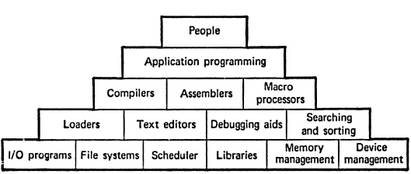
Foundation of System Programming
The basic need of system software is to achieve the following goals :-
To achieve efficient performance of the system
To make effective execution of general user program
To make effective utilization of human resources
To make available new, better facilities
DR.D.Y.PATIL INSTITUTE OF TECHNOLOGY
DR.D.Y.PATIL INSTITUTE OF TECHNOLOGY

Slide 6
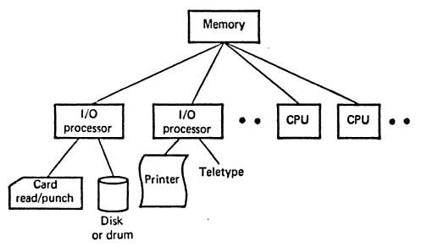
General Hardware Organization of Computer System
DR.D.Y.PATIL INSTITUTE OF TECHNOLOGY
DR.D.Y.PATIL INSTITUTE OF TECHNOLOGY
Notes:
Memory is device where information id stored. Processors are the devices that operate on this information. The information is stored in form of ones and zeros each of which called bit. Bits are grouped to called words, characters, bytes.
6

Slide 7


Operating System
It is the collection of system programs which acts as an interface between user and the computer and computer hardware.
The purpose of an operating system is to provide an environment in which A user can execute programs in a convenient manner
1) Single User Operating system
An operating system that allows a single person to use or access a computer at a time is called single user operating system. For example, DOS and Windows 95 are single user operating systems.
2) Multiuser Operating System
An operating system that allows more than one user to access a computer at a time is called multi user operating system. For example, Unix, Linux, Windows 2000 server
3)Single Tasking operating system
An operating system that allows the user to perform only one task at a time is called single tasking operating system. For example, DOS is a single tasking operating system.
4) Multi Tasking operating system
An operating system that allows the user to perform more than one tasks at a time is called multi tasking operating system. For example, Windows, Unix, Linux are multi tasking operating systems.
5) Network operating system
An operating system that supports network is called network operating system. It normally works on a server. examples of network operating system are Windows NT Server, Windows 2000 Server, UNIX, and Linux.
6) Real Time operating system
A real time operating system is a very fast operating system. It responds to a certain input extremely quickly. Example:-Air Traffic Control Systems,

Slide 8
Cont…
Memory is a device where information is stored.
A processor is a device that perform a sequence of operations specified by instruction in memory.
There are two types of processors
Input/Output (I/O) Processor concerns with transfer of data between memory and peripheral devices
Central Processing Unit (CPU) concerns with the manipulation of data stored in memory
DR.D.Y.PATIL INSTITUTE OF TECHNOLOGY
DR.D.Y.PATIL INSTITUTE OF TECHNOLOGY
Notes:
Information stored in memory is coded into groups of bits that may be interpreted as characters, instructions or numbers.
8

Slide 9
Component of System Programming
Assemblers
Loaders
Linker
Macros
Compilers
Formal Systems
DR.D.Y.PATIL INSTITUTE OF TECHNOLOGY
DR.D.Y.PATIL INSTITUTE OF TECHNOLOGY

Slide 10
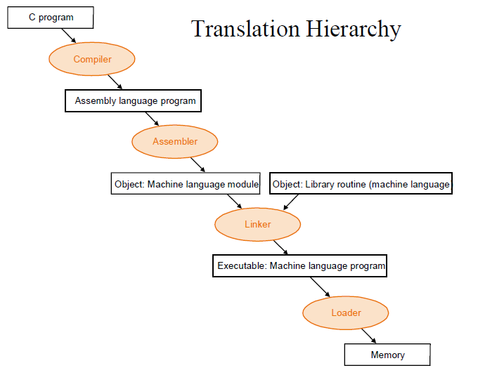
Translation Hierarchy

Slide 11

Translators
Assembler:-
These are the system programs which will automatically translate the assembly language program in to the machine language program
Source program Assembly Lang. Prog.
Target program / M/C Lang. Prog.
Assembler
Database
DR.D.Y.PATIL INSTITUTE OF TECHNOLOGY
DR.D.Y.PATIL INSTITUTE OF TECHNOLOGY

Slide 12
Translators
Complier:-
These are the system programs which will automatically translate the High level language program in to the machine language program
Source program High level Lang. Prog.
Target program / M/C Lang. Prog.
Compiler
Database
DR.D.Y.PATIL INSTITUTE OF TECHNOLOGY
DR.D.Y.PATIL INSTITUTE OF TECHNOLOGY

Slide 13
Translators
Cross Assembler:-
These are the system programs which will automatically translate the Assembly Language program compatible with M/C A, in to the machine language program compatible with M/C A
Source program Assembly Lang. Prog. Compatible with M/C A
Target program / M/C Lang. Prog. Compatible with M/C A
Cross Assembler
M/C B
DR.D.Y.PATIL INSTITUTE OF TECHNOLOGY
DR.D.Y.PATIL INSTITUTE OF TECHNOLOGY

Slide 14
Translators
Cross Compiler:-
These are the system programs which will automatically translate the HLL program compatible with M/C A, in to the machine language program compatible with M/C A , but the underlying M/C is M/C B
Interpreter
It is the language translator which execute source program line by line with out translating them into machine language.
Source program HLL Prog.
Compatible with M/C A
Target program / M/C Lang. Prog.
Cross Compiler
M/C B
DR.D.Y.PATIL INSTITUTE OF TECHNOLOGY
DR.D.Y.PATIL INSTITUTE OF TECHNOLOGY

Slide 15
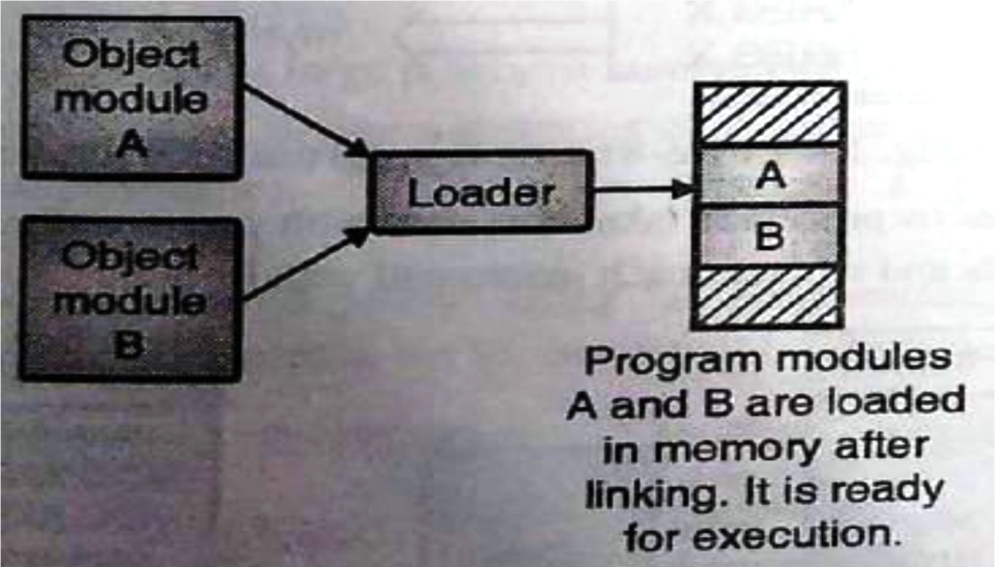
Loader
A Loader is system program that place the object program into main memory and prepares it for execution.
Basic functions of loader
Allocation
Linking
Relocation
Loading
Types of Loader
Compile-and-go Loader
Relocating Loader
Direct Linking Loader
Absolute Loader
General Loader
Dynamic Loader
DR.D.Y.PATIL INSTITUTE OF TECHNOLOGY
DR.D.Y.PATIL INSTITUTE OF TECHNOLOGY

Slide 16
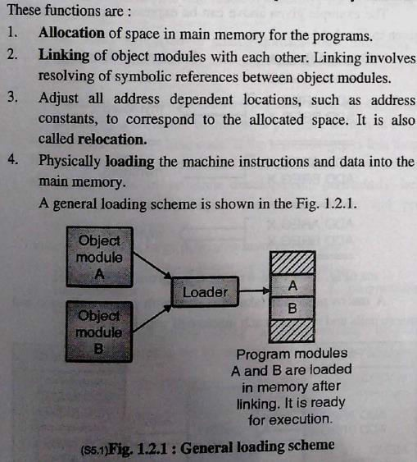
Basic function of loader
DR.D.Y.PATIL INSTITUTE OF TECHNOLOGY
DR.D.Y.PATIL INSTITUTE OF TECHNOLOGY

Slide 17
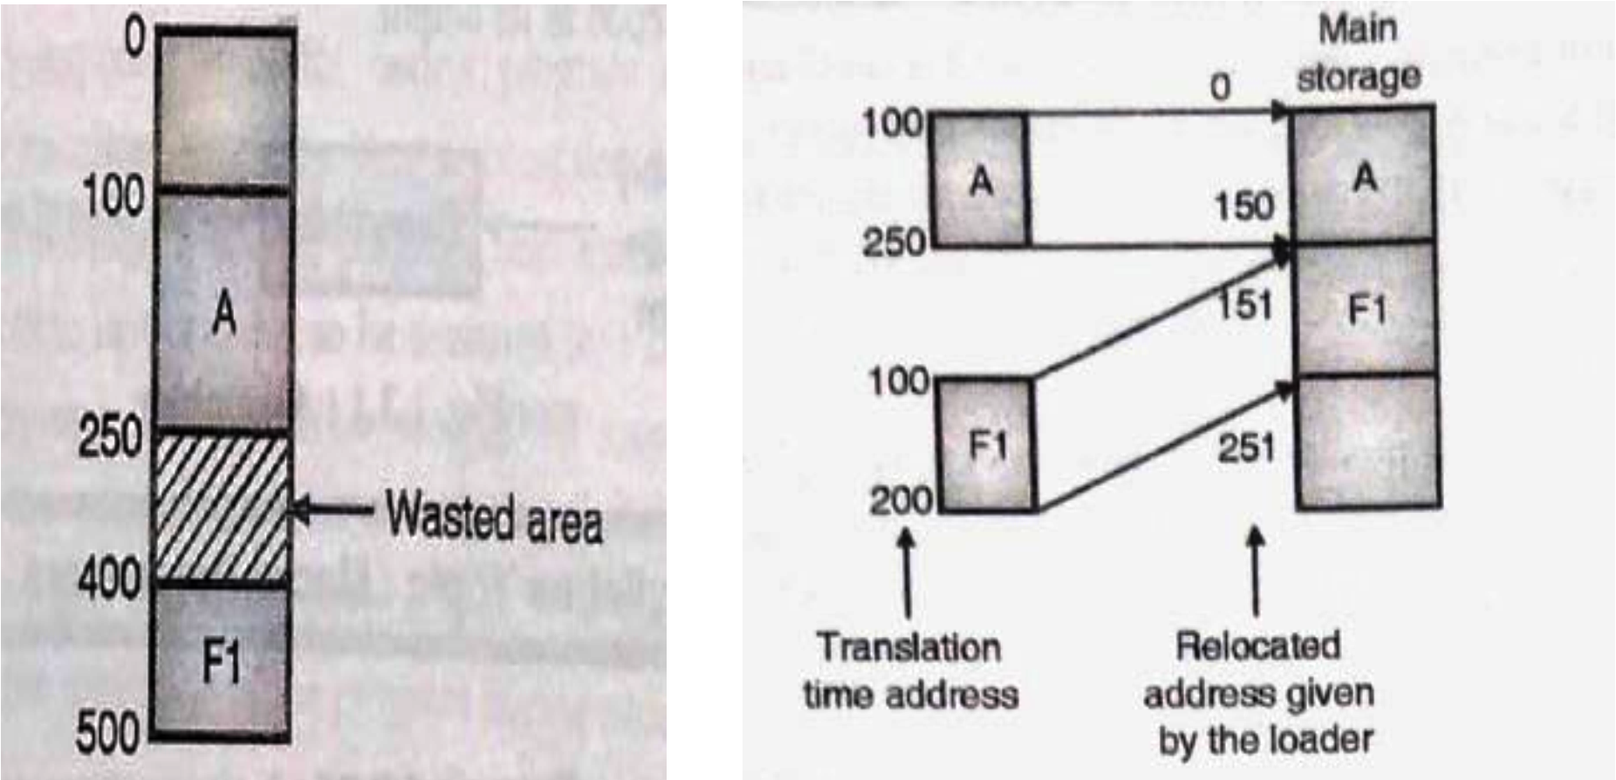
Relocation
DR.D.Y.PATIL INSTITUTE OF TECHNOLOGY
DR.D.Y.PATIL INSTITUTE OF TECHNOLOGY

Slide 18

Macro & Macro processor
Macro
– Macro is a single line abbreviation for a group of instruction.
--------Start of definition
-------- Macro name
Sequence of instructions to be abbreviated.
MACRO INCR
A 1,DATA
A 2,DATA A 3,DATA
MEND
-------- End of definition
DR.D.Y.PATIL INSTITUTE OF TECHNOLOGY
DR.D.Y.PATIL INSTITUTE OF TECHNOLOGY

Slide 19
Example
 | MACRO
 | INCR
 | A | 1, DATA
 | A | 2, DATA
 | A | 3, DATA
 | MEND
 | …
 | INCR
 | …
 | INCR
 | …
DATA | DC | F’5’
 | …
DR.D.Y.PATIL INSTITUTE OF TECHNOLOGY
DR.D.Y.PATIL INSTITUTE OF TECHNOLOGY

Slide 20
Macro in C
#include<stdio.h>
#define AND &&
#define ARANGE (a>25 AND a<50)
void main()
{
int a = 30;
if(ARANGE)
printf(“within range”);
else
printf(“out of range”);
}
DR.D.Y.PATIL INSTITUTE OF TECHNOLOGY
DR.D.Y.PATIL INSTITUTE OF TECHNOLOGY

Slide 21
Linking and Linker
Linking
– The Process of merging many object modules to form a single object program is called as linking.
Linker
The Linker is the software program which binds many object modules to make a single object program.
Once the assembler produces an object program, the program must be placed into memory and executed.
It is the job of the loader to assure that object programs are placed in memory in an executable form.
There are different types of loaders like compile-and-go, absolute, direct linking, etc.
Tool that merges object files produced by separate compilation.
Perform three task
Searches the program to find the library routine
Determine the memory location.
Resolve references among files.
DR.D.Y.PATIL INSTITUTE OF TECHNOLOGY
DR.D.Y.PATIL INSTITUTE OF TECHNOLOGY

Slide 22
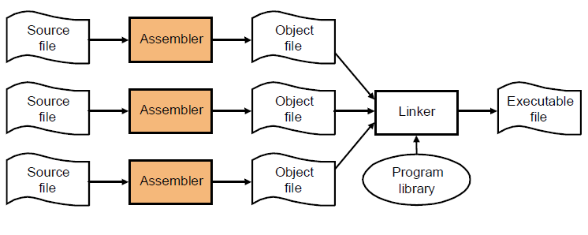
Process for Producing Executable File
DR.D.Y.PATIL INSTITUTE OF TECHNOLOGY
DR.D.Y.PATIL INSTITUTE OF TECHNOLOGY

Slide 23
Assembly Language
A spectrum of languages to communicate with the computer
It is the most machine dependent language used by programmer
A mnemonics are used to understand the machine language.
Assembly language translate the mnemonics in the machine language.
English | Best for Programmer
PL/I, FORTRAN
…
…
…
Assembly Language
Mnemonic Machine Language
Machine Language | Best for machine
DR.D.Y.PATIL INSTITUTE OF TECHNOLOGY
DR.D.Y.PATIL INSTITUTE OF TECHNOLOGY

Slide 24
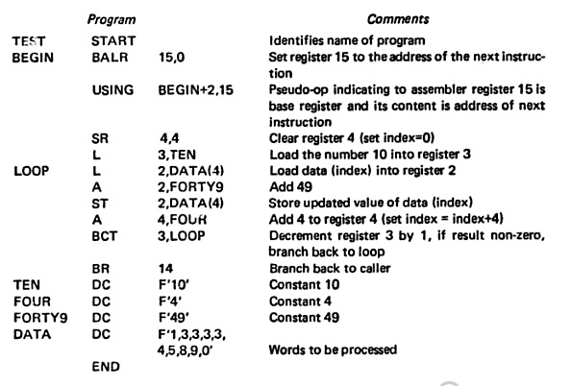
Example
DR.D.Y.PATIL INSTITUTE OF TECHNOLOGY
DR.D.Y.PATIL INSTITUTE OF TECHNOLOGY

Slide 25
Compilers
The high-level languages are processed by compilers and interpreters.
A compiler is a program that accept a program written in a high-level language and produces an object program.
An interpreter is a program that appears to execute a source program.

Slide 26
Formal System
It consists of an alphabets, a set of words called axioms and a finite set of relations called rules of inference.
Formal system are used to specify the syntax and semantics of programming language.
Examples of formal systems are
Set theory
Boolean algebra
Post system
Backus normal form
Notes:
The formal system are important in designing, implementation and the study of programming language.
26

Slide 27
INTRODUCTION TO COMPILERS

Slide 28
What is a Compiler?
A compiler is a computer program that translates a program in a source language into an equivalent program in a target language.
A source program/code is a program/code written in the source language, which is usually a high-level language.
A target program/code is a program/code written in the target language, which often is a machine language or an intermediate code.
Source program
compiler
Target program
Error message

Slide 29
The Structure of a Compiler (1)
Any compiler must perform two major tasks
Analysis of the source program
Synthesis of a machine-language program
Compiler
Analysis
Synthesis
Notes:
29

Slide 30
Compilers and Interpreters
“Compilation”
Translation of a program written in a source language into a semantically equivalent program written in a target language
Oversimplified view:
Input
Source
Program
Compiler
Target
Program
Error messages
Output
Notes:
30

Slide 31
Compilers and Interpreters (cont’d)
“Interpretation”
Performing the operations implied by the source program
Oversimplified view:
Source
Program
Interpreter
Output
Input
Error messages

Slide 32
Compilers and Interpreters (cont’d)
Compiler: a program that translates an executable program in one language into an executable program in another language
Interpreter: a program that reads an executable program and produces the results of running that program

Slide 33
The Many Phases of a Compiler
Source Program
1
Lexical Analyzer
2
Syntax Analyzer
3
Semantic Analyzer
Symbol-table Manager
Error Handler
4
Intermediate Code Generator
5
Code Optimizer
6
Code Generator
Target Program
Notes:
33

Slide 34
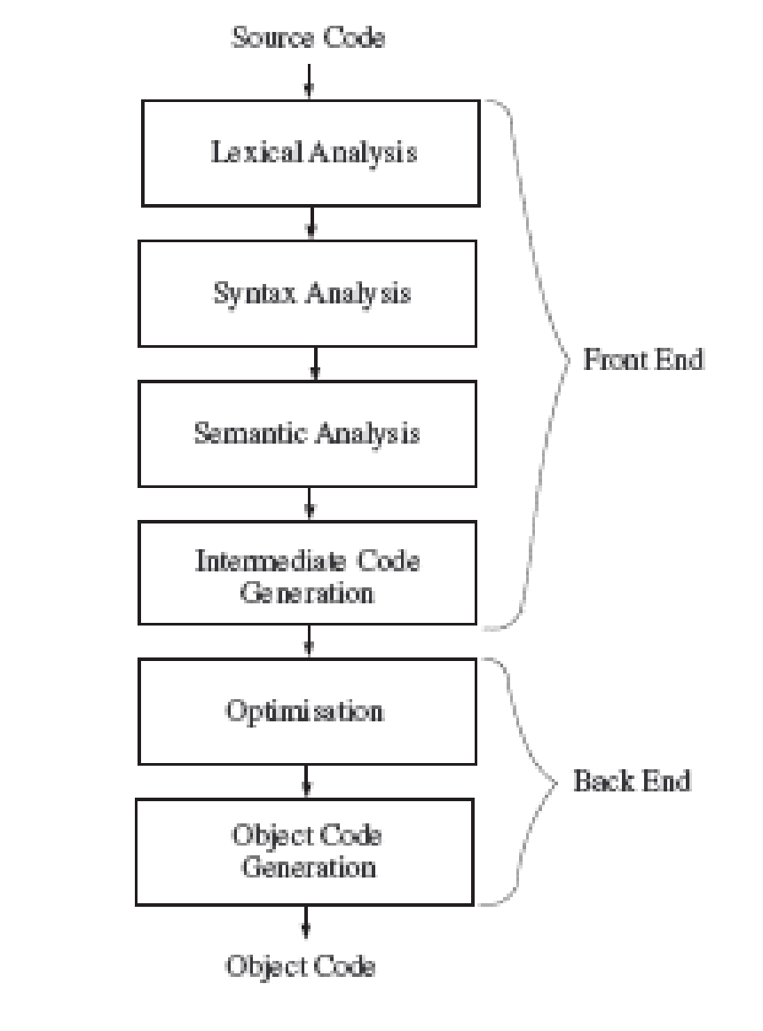
Grouping of phases

Slide 35
Process of Compiling
Stream of characters
scanner
Stream of tokens
parser
Parse/syntax tree
Semantic analyzer
Annotated tree
Intermediate code generator
Intermediate code
Code optimization
Intermediate code
Code generator
Target code
Code optimization
Target code

Slide 36
PHASE OF A COMPILER:
Analysis of Language1
Synthesis of Language 2
ANALYSIS
SYNTHESIS
LEXICAL
ANALYSIS
INTERMEDIATE
CODE GENERATION
SYNTAX
ANALYSIS
CODE
OPTIMIZATION
SEMANTIC
ANALYSIS
TARGET CODE
GENERATION

Slide 37
Analysis
In compiling, analysis has three phases:
Linear analysis: stream of characters read from left-to-right and grouped into tokens; known as lexical analysis or scanning
Hierarchical analysis: tokens grouped hierarchically with collective meaning; known as parsing or syntax analysis
Semantic analysis: check if the program components fit together meaningfully

Slide 38
Phase 1. Lexical Analysis
Lexical Analysis involves scanning of the source program from left to right and separating them into tokens. A token is a sequence of characters having collective meaning.
For Example:
Position := initial + rate * 60 ;
_______ __ _____ _ ___ _ __ _
All are tokens
Blanks, Line breaks, etc. are scanned out
Notes:
38

Slide 39
LEXICAL ANALYZER:
Lexical Analyzer or Linear Analyzer breaks the sentence into tokens. For Example following assignment statement :-
position = initial + rate * 60
Would be grouped into the following tokens:
1. The identifier position.
2. The terminal symbol =.
3. The identifier initial.
4. The terminal symbol +.
5. The identifier rate.
6. The terminal symbol *.
7. The literal 60.

Slide 40
Example: Scanner
Input is sequence of characters.
If x>100 then y :=1 else y:=2;
Output is tokens (lexemes).
Terminal symbol table is a fixed table for any computer.
Literal table is generated during lexical analysis.
Symbol table is generated during lexical analysis.
Uniform symbol table is generated during lexical analysis.

Slide 41
Phase 2. Hierarchical Analysis Parsing or Syntax Analysis
Usually a source statement is represented using a parse tree.
A syntax tree is a compress representation of a parse tree
assignment statement
:=
identifier
expression
+
position
expression
expression
*
identifier
expression
expression
initial
identifier
number
rate
60
Nodes of tree are constructed using a grammar for the language
Notes:
41

Slide 42
SYNTAX ANALYSIS:
Syntax analysis is also called PARSING. It involves grouping the tokens of the source program into grammatical phrases that are used by the compiler to synthesize output. It checks the code syntax using CFG : i.e. the set of rules .For example: if we have grammar of the form:
E = E
E = E + E
E = E * E
E = const.
Then corresponding parse tree derivation is:
E🡪 E = E🡪id = E+E🡪id = id + E*E🡪id = id + id*60

Slide 43
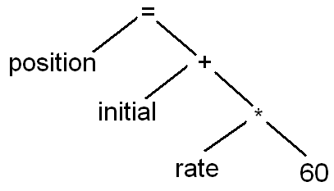
Parser thus consumes these tokens .If any token is left unconsumed, the parser gives an error /warning.
Following is the parse tree for the taken equation:-
Parser parses the tree such that –if all the tokens are consumed by the parse tree, no non-terminal should be left to be expanded
In syntax tree, operators appears as internal nodes and operand as leaf nodes.

Slide 44
Phase 3. Semantic Analysis
Find More Complicated Semantic Errors and Support Code Generation
Parse Tree Is Augmented With Semantic Actions
:=
:=
position
+
position
+
initial
*
initial
*
rate
60
rate
inttoreal
60
Compressed Tree
Conversion Action
Notes:
44

Slide 45
Example of semantic Errors
5*”ABC” (Multiplication of int and str is not permitted )
Multiplication of two pointer p1 and p2. p1*p2 is not allowed.
Many languages do not allow mixing of integer and real number in an expression.

Slide 46
SEMANTIC ANALYSIS
The semantic analysis phase checks source program for semantic errors and gathers type information for the subsequent code-generation phase . In this checks are performed to ensure that the components of a program fit together meaningfully.
For example: we have a sample code:
int a; int b;
char c[ ];
a=b + c; (Type check is done)

Slide 47
SYNTHESIS PHASE OF COMPILATION:
Phase 4 INTERMEDIATE CODE GENERATION:
Before generation of the machine code, the compiler create an intermediate form of the source program.
Intermediate code separates machine-independent phases (lexical, Syntax, Semantic) of a compiler form the machine-dependent phases(code generation) of a compiler.
The intermediate representation can have a variety of form.
These form include:
Three address code
Quadruple
Triple
Postfix Notation
Syntax tree

Slide 48
e.g. z=x+y*A
1. Three address code: Each instruction has maximum 3 operands.
temp1 = y * A
Temp2 = x + temp1
Z = temp2
2. Quadruple representation: Quadruple representation format
Operator | Operand 1 | Operand 2 | Result
Operator | Operand 1 | Operand 2 | Result
* | Y | A | Temp1
+ | X | Temp 1 | Temp 2
= | Temp 2 | - | z

Slide 49
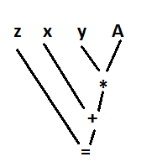
3. Triple representation:
4. Postfix Notation:
Z=x+y*A is given by zxyA*+=
5. Syntax tree:
Operator | Operand 1 | Operand 2
* | Y | A
+ | X | (1)
= | z | (2)

Slide 50
Phase 5 CODE OPTIMIZATION
The code optimization phase attempts to improves the intermediate code, so that faster-running machine code result. Some optimization are trivial. So the final code for example above will be:-
temp1 =y*A // removed unnecessary
z=x+temp1 //variables
In “optimizing compilers” ,a significant amount of time is spent on this phase. How-ever ,there are simple optimizations that significantly improve the running time of the target program with out slowing down the compilation too much.

Slide 51
Phase 6 CODE GENERATION
The Final phase of the compiler is the generation of the target code, consisting normally of the relocatable machine code or assembly code. Compilers may generate many types of target codes depending on M/C while some compilers make target code only for a specific M/C. Translation of the taken code might become:
Intermediate code Assembly code
1. temp1 = y*A MOVER AREG, y
MUL AREG, A
MOVEM AREG, temp1
2. z= x + temp1 MOVER AREG, x
ADD AREG, temp1
MOVEM AREG, z

Slide 52
The Phases of a Compiler
Phase | Output | Sample
Programmer (source code producer) | Source string | A=B+C;
Scanner (performs lexical analysis) | Token string | ‘A’, ‘=’, ‘B’, ‘+’, ‘C’, ‘;’ And symbol table with names
Parser (performs syntax analysis based on the grammar of the programming language) | Parse tree or abstract syntax tree | ; | = / \ A + / \ B C
Semantic analyzer (type checking, etc) | Annotated parse tree or abstract syntax tree
Intermediate code generator | Three-address code, quads, or RTL | int2fp B t1 + t1 C t2 := t2 A
Optimizer | Three-address code, quads, or RTL | int2fp B t1 + t1 #2.3 A
Code generator | Assembly code | MOVF #2.3,r1 ADDF2 r1,r2 MOVF r2,A

Slide 53
Reviewing the Entire Process
position := initial + rate * 60
lexical analyzer
id1 := id2 + id3 * 60
syntax analyzer
:=
id1
+
id2
*
id3
60
semantic analyzer
:=
Symbol Table
id1
+
Errors
id2l
*
position ....
initial ….
rate….
id3
inttoreal
60
intermediate code generator
Notes:
53

Slide 54
Assemblers

Slide 55
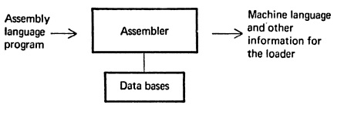
Introduction
An assembler is a program that accept an assembly language program and produces it machine language equivalents

Slide 56
Assembly Language
An assembly language is a machine dependent, low level programming language which is specific to certain computer system
Compared to machine languages, it provides three basic features
Mnemonic operation code
Symbolic operation
Data declaration

Slide 57
Cont…
An assembly language statement has the format
[label] <Opcode> <operand spec> [<operand spec>…]
For example,
A label is associated as a symbolic name
SR. NO | LABEL | OPCODE | OPERAND
1 |  | MOVER | BREG, ONE
2 | ONE | DC | ‘1’
Notes:
57

Slide 58
Cont…
In assembly language, each statement has two operands,
First operand is always register (AREG, BREG, CREG, DREG, etc)
Second operand refers to a memory word using symbolic name.

Slide 59
Mnemonic Operations
Instruction Op-code | Assembly Mnemonic | Remarks
00 | STOP | Stop Execution
01 | ADD
02 | SUB
03 | MULT
04 | MOVER | Move memory to register
05 | MOVEM | Move register to memory
06 | COMP | Set condition code
07 | BC | Branch on condition
08 | DIV | Analogous to SUB
09 | READ
10 | PRINT

Slide 60
Cont…
The MOVE instruction move a value between a memory word and a register.
All arithmetic is performed in a register
A comparison instruction sets a condition code analog to subtract code.
The condition code can be tested by a BC instruction. Its format is
BC <condition code>, <memory address>
where , condition code is a simple character string like LT, LE, EQ, GT, GE and ANY

Slide 61
Machine Instruction Format
The machine instruction format is
For example
Sign
Op-code
Reg operand
Memory operand
+
0 | 4 | 2 | 1 | 1 | 5
MOVER
BREG
ONE
Notes:
The condition code specified in a BC statement is encoded into the first operand position using code 1-6 for specification LT, LE, EQ, GT, GE and ANY
61

Slide 62
Cont…
The register operands are
Instruction Op-code | Register
1 | AREG
2 | BREG
3 | CREG
4 | DREG

Slide 63
A Simple Assembly Language
 | START | 101
 | READ | N | 101 | + 09 0 112
 | MOVER | BREG, ONE | 102 | + 04 2 114
 | MOVEM | BREG, TERM | 103 | + 05 2 115
AGAIN | MULT | BREG, TERM | 104 | + 03 2 115
 | MOVER | CREG, TERM | 105 | + 04 3 115
 | ADD | CREG, ONE | 106 | + 01 3 114
 | COMP | CREG, N | 107 | + 06 3 112
 | BC | LE, AGAIN | 108 | + 07 2 104
 | MOVEM | BREG, RESULT | 109 | + 05 2 113
 | PRINT | RESULT | 110 | + 10 0 113
 | STOP |  | 111 | + 00 0 000
N | DS | 1 | 112
RESULT | DS | 1 | 113
ONE | DC | ‘1’ | 114 | + 00 0 001
TERM | DS | 1 | 115
 | END

Slide 64
Assembly Language Statement
An assembly language program contains three kind of statements
Imperative statement
Declarative statement
Assembler directives

Slide 65
Imperative Statement
It indicates the actions to be performed.
For example,
Sr. No. | Op-code | Operand | Meaning
1 | MOVER | BREG, ONE | Move memory to register
2 | MOVEM | BREG, TERM | Move register to memory
3 | MULT | BREG, TERM | Perform multiplication
4 | ADD | CREG, ONE | Perform addition
5 | COMP | CREG, N | Comparison statement
6 | BC | LE, AGAIN | Conditional statement
7 | PRINT | RESULT | Printing operation

Slide 66
Declarative Statement
The syntax of declarative statement is as
[label] DS <constant>
[label] DC ‘<value>’
For example
Sr. No. | Label | Op-code | Operand | Meaning
1 | N | DS | 1 | Reserve a memory of 1 word
2 | RESULT | DS | 1 | Reserve a memory of 1 word
3 | ONE | DC | ‘1’ | Memory word store constant
4 | TERM | DS | 200 | Reserve a memory of 200 word

Slide 67
Cont…
An assembly program can use constants in two ways
As immediate operand:
This feature is provided by the target machine
For example, ADD AREG, 5
As literals:
A literal is an operand with the syntax =‘<value>’
For example, ADD AREG, =‘5’

Slide 68
Example
 | START | 200
 | MOVER | AREG, =‘5’ | 200
 | MOVEM | AREG, A | 201
LOOP | MOVER | AREG, A | 203
 | …
 | LTORG
 |  | =‘5’ | 211
 |  | =‘1’ | 212
 | …
 | BC | LT, BACK | 215
 | …
BACK | EQU | LOOP
B | DS | 1 | 218
 | END

Slide 69
Assembler Directives
Assembler directives provides some directives to the assembler to perform certain actions.
For example,
START <constant>
This directive indicates, assembler should be start with memory address <constant>

Slide 70
Advantages of Assembly Language
It is mnemonic
Reading is easier
Ease of programming than machine language

Slide 71
Disadvantage of Assembly Language
The disadvantage of assembly language is that it requires the use of an assembler to translate a source program into object code

Slide 72
Design Specification of An Assembler
It is four step approach to develop a design specification for an assembler
Identify the information to perform a task
Design a suitable data structure to record information
Determine processing to obtain and maintain the information
Determine the processing to perform the task.

Slide 73
Cont…
There are two phases in assembly language programming
Analysis Phase:
Isolate the labels, mnemonics and operands
Generate symbol table (SYMTAB)
Validate mnemonic through mnemonic table
Synthesis Phase:
Obtain the machine code from mnemonic table
Obtain the address of operand from symbol table

Slide 74
Cont…
Mnemonic | Op-code | Length
ADD | 01 | 1
SUB | 02 | 1
Mnemonic Table
Analysis Phase
Synthesis Phase
Source Program
Target Program
Symbol | Address
AGAIN | 104
N | 113
Symbol Table

Slide 75
Example
 | START | 101
 | READ | N | 101 | + 09 0 112
 | MOVER | BREG, ONE | 102 | + 04 2 114
 | MOVEM | BREG, TERM | 103 | + 05 2 115
AGAIN | MULT | BREG, TERM | 104 | + 03 2 115
 | MOVER | CREG, TERM | 105 | + 04 3 115
 | ADD | CREG, ONE | 106 | + 01 3 114
 | COMP | CREG, N | 107 | + 06 3 112
 | BC | LE, AGAIN | 108 | + 07 2 104
 | MOVEM | BREG, RESULT | 109 | + 05 2 113
 | PRINT | RESULT | 110 | + 10 0 113
 | STOP |  | 111 | + 00 0 000
N | DS | 1 | 112
RESULT | DS | 1 | 113
ONE | DC | ‘1’ | 114 | + 00 0 001
TERM | DS | 1 | 115
 | END

Slide 76
Cont…
Mnemonic | Op-code | Length
ADD | 01 | 1
SUB | 02 | 1
MULT | 03 | 1
MOVER | 04 | 1
MOVEM | 05 | 1
COMP | 06 | 1
BC | 07 | 1
DIV | 08 | 1
READ | 09 | 1
PRINT | 10 | 1
Symbol | Address
AGAIN | 104
N | 113
RESULT | 114
ONE | 115
TERM | 116
Symbol Table
Mnemonic Table

Slide 77
Synthesis Phase
Consider the assembly statement
MOVER BREG, ONE
To synthesize the machine instruction we must have
Address of the memory word of symbol ONE
Machine operation code of MOVER
0 | 4 | 2 | 1 | 1 | 5
MOVER
BREG
ONE

Slide 78
Analysis Phase
The primary function performed by the analysis phase is the building of the symbol table.

Slide 79
Symbol Table Generation
The symbol table has two fields
To determine the address of symbols, first fix the address of all program element. This is called as memory allocation.
The memory allocation is done by the help of LC
Symbol | Address

Slide 80
Cont…
To allocate the memory the LC is used
LC always contains the address of the next memory word
LC is initialize with the START statement
LC is updated by the length of the instruction
The Length of the instruction is obtained from the mnemonic table.

Slide 81
Example
 | START | 101
 | READ | N | 101 | + 09 0 112
 | MOVER | BREG, ONE | 102 | + 04 2 114
 | MOVEM | BREG, TERM | 103 | + 05 2 115
AGAIN | MULT | BREG, TERM | 104 | + 03 2 115
 | MOVER | CREG, TERM | 105 | + 04 3 115
 | ADD | CREG, ONE | 106 | + 01 3 114
 | COMP | CREG, N | 107 | + 06 3 112
 | BC | LE, AGAIN | 108 | + 07 2 104
 | MOVEM | BREG, RESULT | 109 | + 05 2 113
 | PRINT | RESULT | 110 | + 10 0 113
 | STOP |  | 111 | + 00 0 000
N | DS | 1 | 112
RESULT | DS | 1 | 113
ONE | DC | ‘1’ | 114 | + 00 0 001
TERM | DS | 1 | 115
 | END

Slide 82
Cont…
Symbol | Address
AGAIN | 104
N | 113
RESULT | 114
ONE | 115
TERM | 116
Symbol Table

Slide 83
Pass Structure of Assembler
Generally, there are two types of assemblers
Single pass assembler
Two pass assembler

Slide 84
Single Pass Assembler
It passes over the source file only once
During the pass, it performs all operations like collecting the labels, address and literals.
The analysis and synthesis of program is done in single pass.

Slide 85
Cont…
The problem of the single pass assembler is to tackle the forward references
For example,
 | START | 101
 | …
 | MOVER | BREG, ONE | 102 | + 04 2 114
 | MOVEM | BREG, TERM | 103 | + 05 2 115
 | …
 | …
ONE | DC | ‘1’ | 114 | + 00 0 001
TERM | DS | 1 | 115
 | END

Slide 86
Two Pass Assembler
Two pass assembler can handle forward references easily.
LC processing is performed in the first pass and symbols defined in the program are entered in the symbol table.
In effect, the first pass perform the analysis of program while the second pass perform the synthesis.

Slide 87
Design of A Two-Pass Assembler
Task performed by the two pass assembler are
Pass I:
Separate the symbol, mnemonic and operand fields
Build the symbol table
Perform LC processing
Construct intermediate representation
Pass II:
Synthesize the target program

Slide 88
Advanced Assembler Directives
ORIGIN
Syntax: ORIGIN <address spec>
Set LC to the address given by <address spec>
EQU
Syntax: <symbol> EQU <address spec>
Define the symbol to represent address given by <address spec>
LTORG
It permit a programmer to specify where literals should be placed

Slide 89
Example
 | START | 200
 | MOVER | AREG, =‘5’ | 200
 | MOVEM | AREG, A | 201
LOOP | MOVER | AREG, A | 202
 | …
 | LTORG
 |  | =‘5’ | 211
 |  | =‘1’ | 212
 | …
 | ORIGIN | LOOP+2
 | MULT | CREG, B | 204
 | …
BACK | EQU | LOOP
B | DS | 1 | 218
 | END

Slide 90
Pass-I of the Assembler
Pass-I uses
Machine Operation Table(OPTAB)
Symbol Table(SYMTAB)
Literal Table(LITTAB)

Slide 91
Cont…
Mnemonic op-code | Class | Mnemonic info
OPTAB
Sybmol | Address | Length
SYMTAB
Literal | address
LITTAB

Slide 92
Pass-I Algorithm
loc_cntr := 0; (default value)
pooltab_ptr :=1; POOLTAB[1]:=1;
littab_ptr:=1;
While next statement is not an END statement
If label is present then
this_label:= symbol in label field;
Enter(this_label, loc_cntr) in SYMTAB.
If an LTORG statement then
Process literals LITTAB[POOLTAB[pooltab_ptr]…LITTAB[lit_tab_ptr-1] to allocate memory and put the address in the address field. Update location counter accordingly.
pooltab_ptr := pooltab_ptr +1;
POOLTAB[pooltab_ptr]:=littab_ptr;

Slide 93
Cont…
If START or ORIGIN statement then
loc_cntr := value specified in the operand field;
If an EQU statement then
this_addr := value of <address_spec>;
Correct the symbtab entry for this_label to (this_label,this_addr)
If a declaration statement then
code:= machine opcode from OPTAB;
size := size of memory are required by DC/DS
loc_cntr := loc_cntr + size;
Generate IC ‘(DL, code)…’

Slide 94
Cont…
If an imperative statement then
code:= machine opcode from OPTAB;
loc_cntr := loc_cntr + instruction length from OPTAB;
If operand is a literal then
this_literal := literal in operand field;
LITTAB[littab_ptr]:= this_literal;
littab_ptr= littab_ptr +1;
else (i.e. operand is a symbol)
this_entry := SYMTAB entry number of operand
Generate IC ‘(IS,code)(S,this_entry)’;

Slide 95
Cont…
Processing of END statement
Perform step 2(b)
Generate IC
Go to pass II

Slide 96
Example
 | START | 200
 | READ | A | 200
 | READ | B | 201
 | MOVER | AREG, =‘5’ | 202
 | MOVER | AREG, A | 203
 | ADD | AREG, B | 204
 | SUB | AREG, =‘6’ | 205
 | MOVEM | AREG, C | 206
 | PRINT | C | 207
 | LTORG
 | MOVER | AREG, =‘15’ | 210
 | MOVER | AREG, A | 211
 | ADD | AREG, B | 212
 | SUB | AREG, =‘16’ | 213
 | DIV | AREG, =‘26’ | 214
 | MOVEM | AREG, C | 215
A | DS | 1 | 216
B | DS | 1 | 217
C | DS | 1 | 218
 | STOP |  | 219
 | END
Notes:
LTORG statement permit a programmer to specify where literals should be placed
96

Slide 97
Cont…
Sybmol | Address | Length
A | 216 | 1
B | 217 | 1
C | 218 | 1
Literal | address
=‘5’ | 208
=‘6’ | 209
=‘15’ | 220
=‘16’ | 221
=‘26’ | 222

Slide 98
Pass-II Algorithm
code_area_address := address of code_area;
Pooltab_ptr :=1;
Loc_cntr:=0;
While next statement is not an END statement
Clear machine_code_buffer;
If an LTORG statement
Process literals in LITTAB[POOLTAB[pooltab_ptr]]…LITTAB[POOLTAB[pooltab_ptr+1]]-1 similar to processing of constants in a DC statement i.e. assemble the literals in machine_code_buffer.
size := size of memory area required for literals;
pooltab_ptr:= pooltab_ptr +1;

Slide 99
Cont…
If a START or ORIGIN statement then
loc_cntr := value specified in operand field;
size:=0;
If a declaration statement
If a DC statement then
Assemble the constant in machine_code_buffer.
size: = size of memory area required by DC/DS;
If an imperative statement
Get operand address from SYMTAB or LITTAB.
Assemble instruction in machine_code_buffer.
size: = size of instruction;

Slide 100
Cont…
if size not equal to 0 then
Move contents of Machine_code_buffer to the address code_area_address + loc_cntr;
loc_cntr := loc_cntr + size;
(Processing of END statement)
Perform steps 2(b) and 2(f).
Write code_area into output file.

Slide 101
Example
 | START | 200
 | READ | A | 200 | +09 0 216
 | READ | B | 201 | +09 0 217
 | MOVER | AREG, =‘5’ | 202 | +04 1 208
 | MOVER | AREG, A | 203 | +04 1 216
 | ADD | AREG, B | 204 | +01 1 217
 | SUB | AREG, =‘6’ | 205 | +02 1 209
 | MOVEM | AREG, C | 206 | +05 1 218
 | PRINT | C | 207 | +10 0 218
 | LTORG
 | MOVER | AREG, =‘15’ | 210 | +04 1 220
 | MOVER | AREG, A | 211 | +04 1 216
 | ADD | AREG, B | 212 | +01 1 217
 | SUB | AREG, =‘16’ | 213 | +02 1 221
 | DIV | AREG, =‘26’ | 214 | +08 1 222
 | MOVEM | AREG, C | 215 | +05 1 218
A | DS | 1 | 216
B | DS | 1 | 217
C | DS | 1 | 218
 | STOP |  | 219
 | END

Slide 102
Exercise
For give source program generate symbol table, literal table
 | START | 100
A | DS | 3 | 100
L1 | MOVER | AREG, B | 103
 | ADD | AREG, C | 104
 | MOVEM | AREG, D | 105
D | EQU | A+1
L2 | PRINT | D | 106
 | ORIGIN | A-1
C | DC | ‘5’ | 099
 | ORIGIN | L2+1
 | STOP |  | 107
B | DC | ‘19’ | 108
 | END

Slide 103
References
D. M. Dhamdhere, “System Programming and Operating System”, TMH

